Slide 1
Chinese Lip Reading
Based on Audio-Visual
Hidden Unit BERT
指導教授：陳冠文
組別：第7組
組員：110550165何存益 110550085房天越

Slide 2
Table of Content
01
02
03
04
05
Introduction
Method
Result
Conclusion
Reference

Slide 3
Introduction
Traditional lip-reading models are typically trained using only visual datasets.
AV-HuBERT[1] employs self-supervised learning to cluster audio and visual features into hidden units, which significantly enhances lip-reading accuracy.
In our project, we adapted AV-HuBERT for the Chinese language by training it on the CMLR dataset[2], a Chinese audio-visual dataset.
Our model demonstrated its ability to distinguish test videos without relying on audio input.

Slide 4
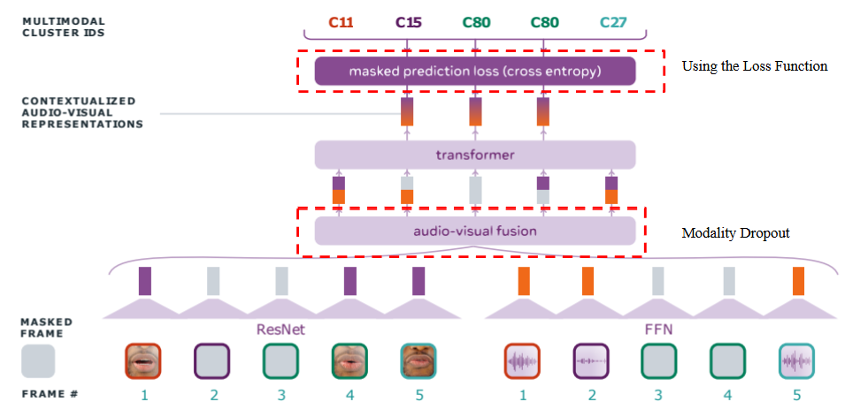
Method
image from Learning Audio-Visual Speech Representation by Masked Multimodal Cluster Prediction

Slide 5
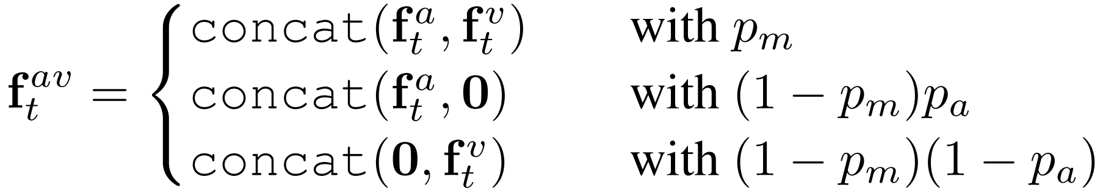
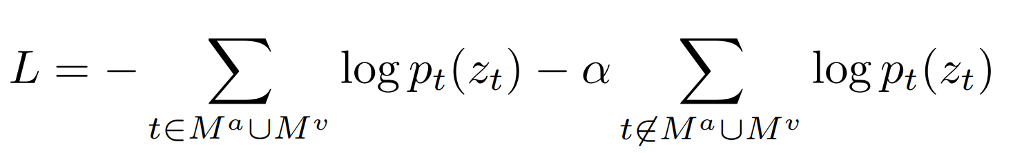
Method
Modality Dropout
Training Loss Function

Slide 6
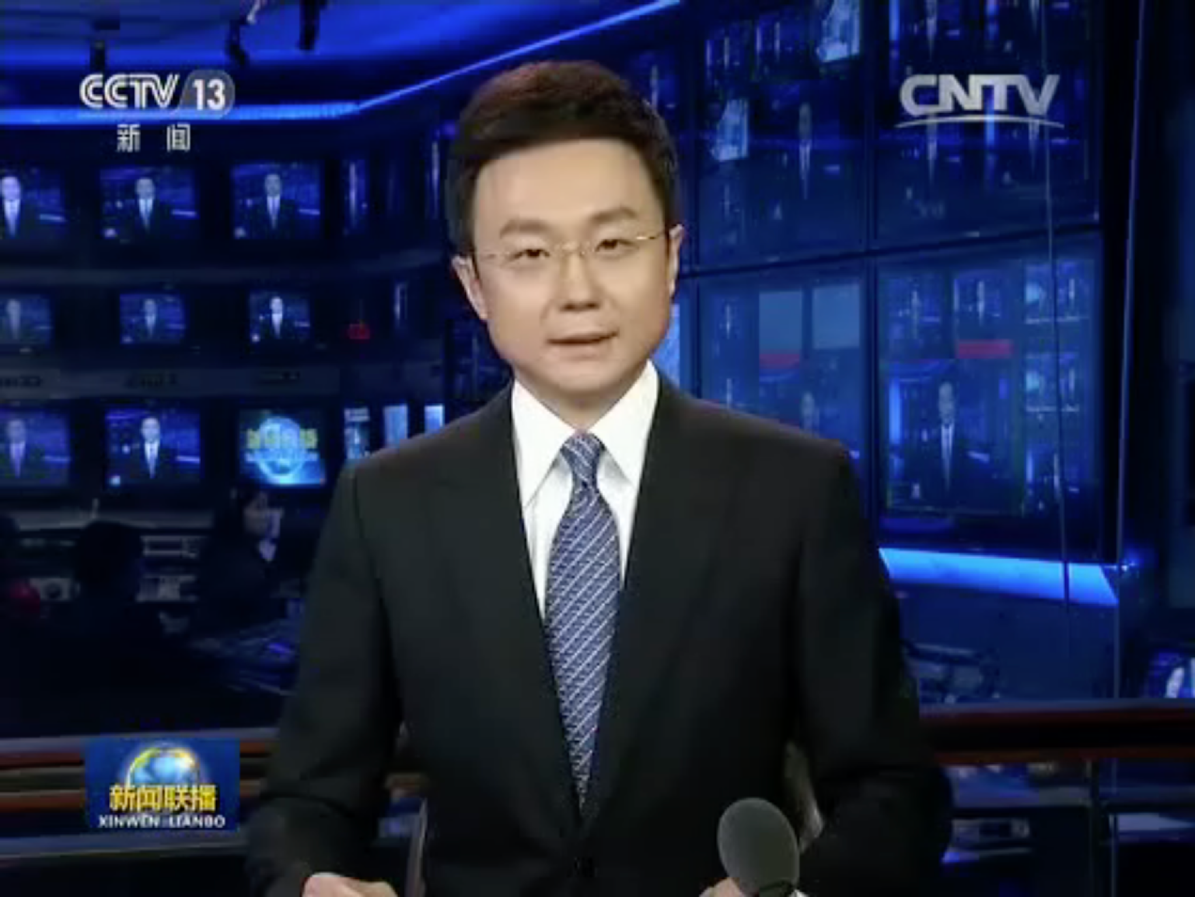


Method - CMLR Preprocessing
Text
推動
社會
的
經濟
穩定
發展
Label
0
1
2
3
4
5
Detect landmark
Extract ROI
Input Video Frame
Video
Turn to 16000Hz
and mono
Input Audio Frame
Audio
Label 0 1 2 3 4 5
Text 推動 社會 的 經濟 穩定 發展

Slide 7
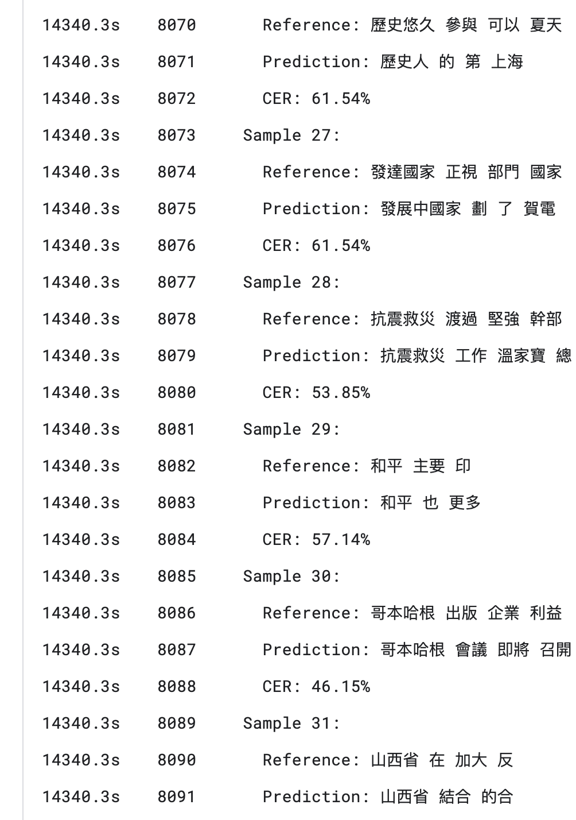
Method - Fine-tune
Finally, we fine-tuned our model, enabling it to predict Chinese content.
▲Part of the results

Slide 8

Method - Generate Vocabulary Table
Unlike English, where words are naturally separated by spaces and can be easily tokenized, Chinese lacks such delimiters, making segmentation more challenging.
We need to find a more suitable tokenization method for Chinese.
SentencePiece

Slide 9
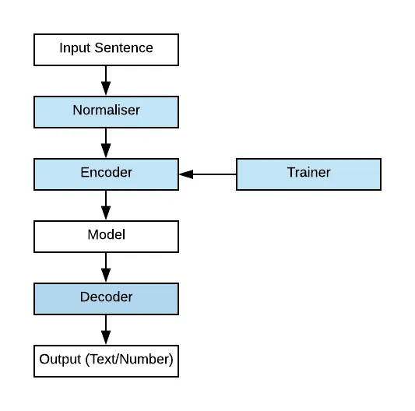
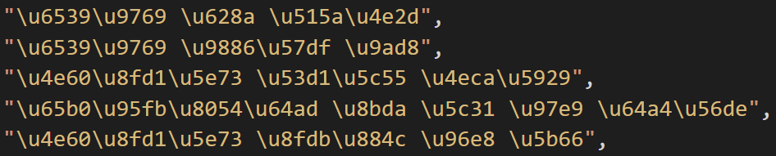
Method - SentencePiece
SentencePiece processes all input by converting it into Unicode characters, enabling unified handling across multiple languages.

Slide 10
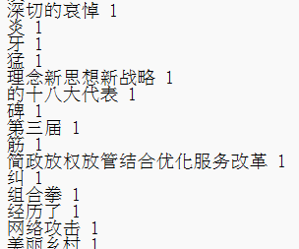
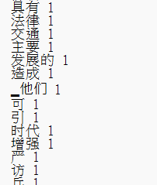
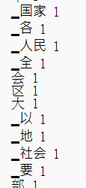
Result - Generate Vocabulary Table
Due to the special structure of Chinese language, we use Character Error Rate (CER) instead of Word Error Rate (WER) that is mentioned in the paper.
 | Sentence Tokenize (Unigram) | the word in CMLR | Word tokenize
CER↓ | 83.27% | 65.07% | 56.35%
Part of Vocab

Slide 11
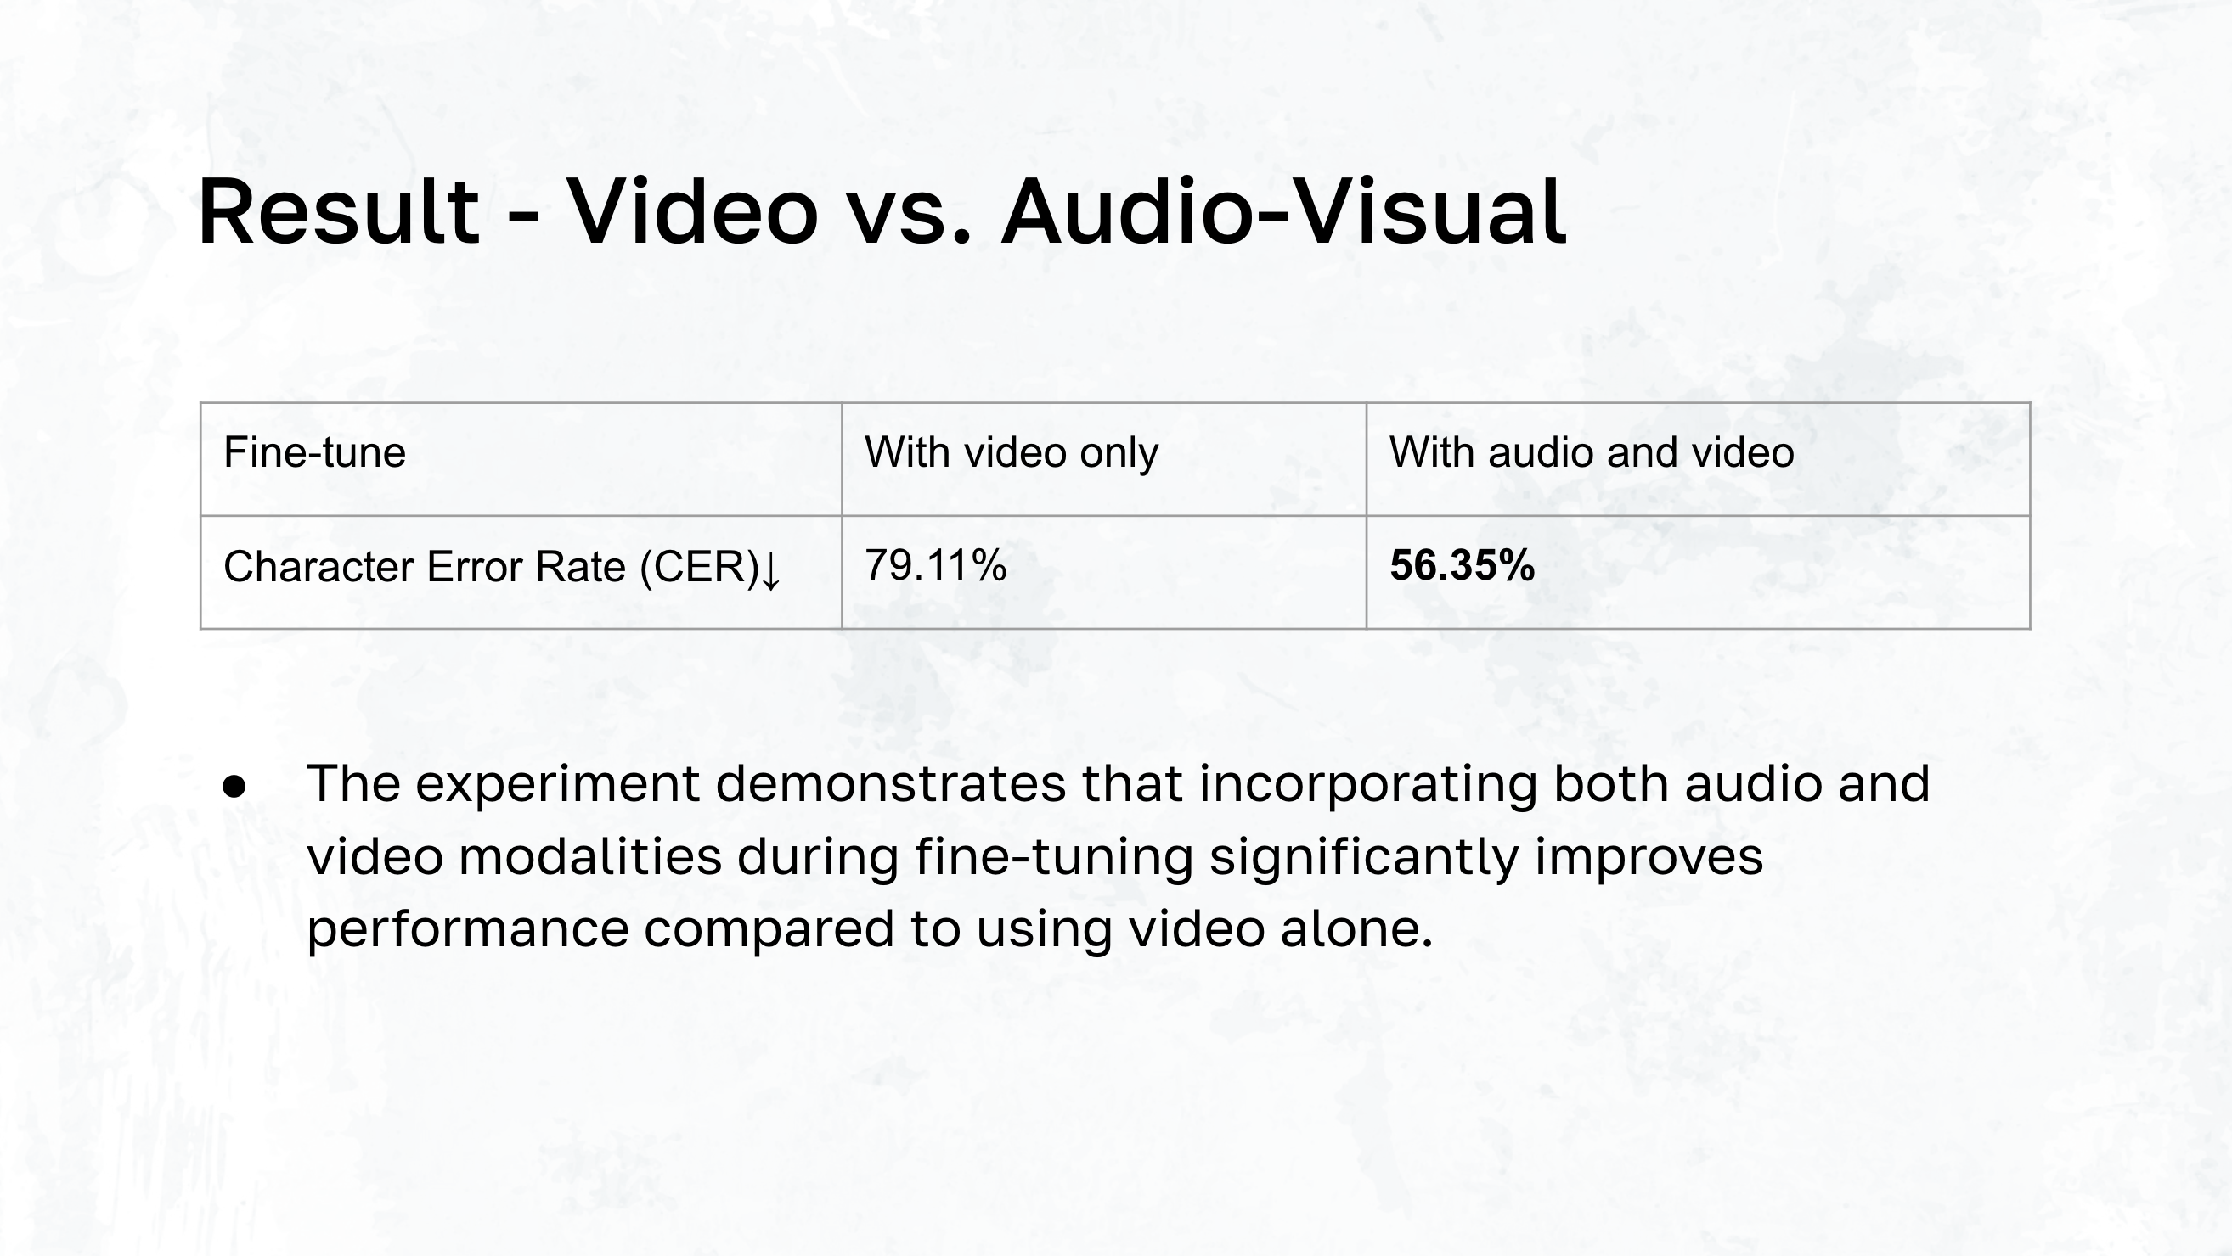

Slide 12
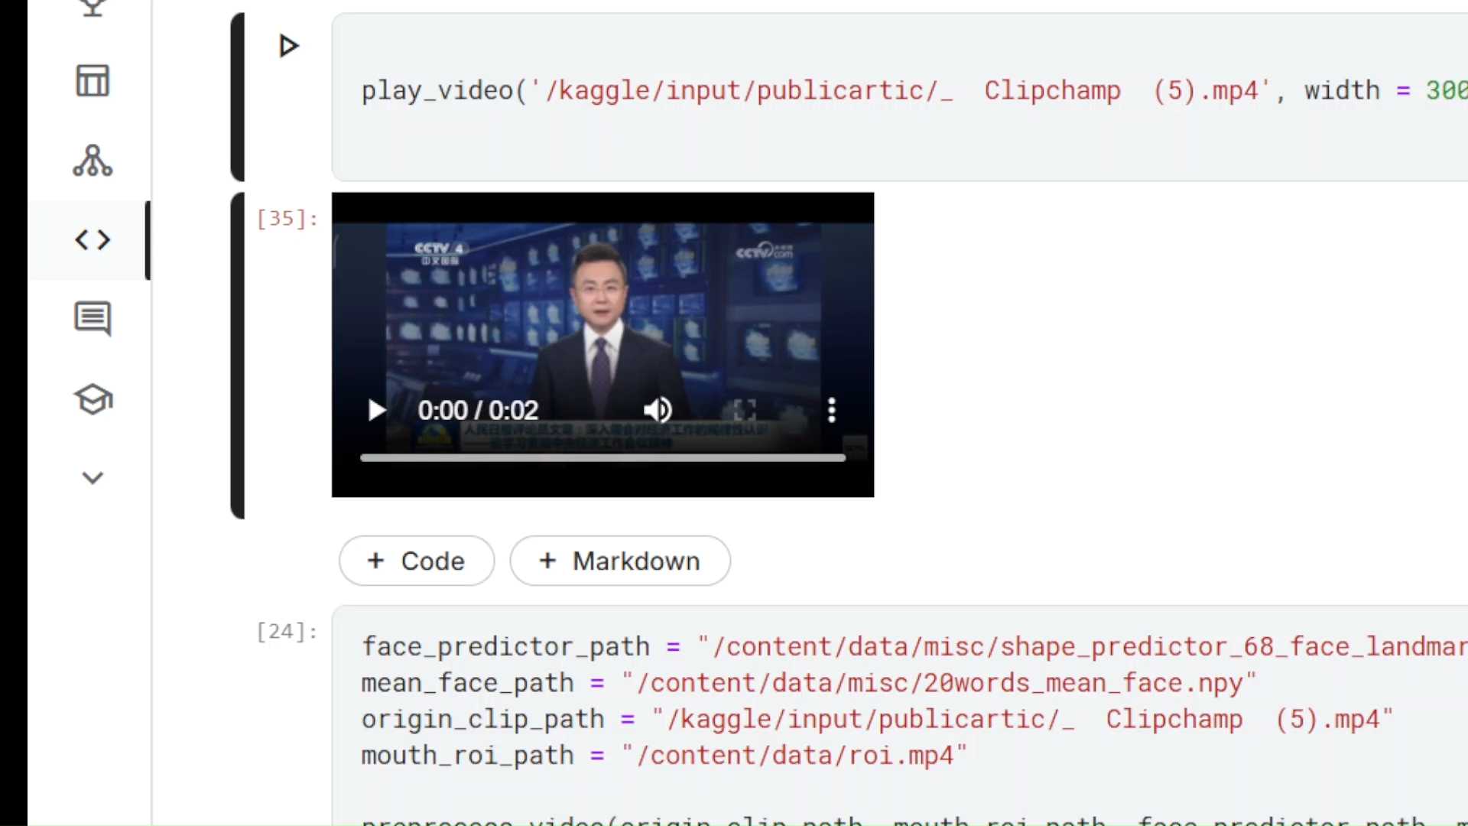

Result - Demo Video
Link
Ground Truth - 人民日报发表评论员文章

Slide 13
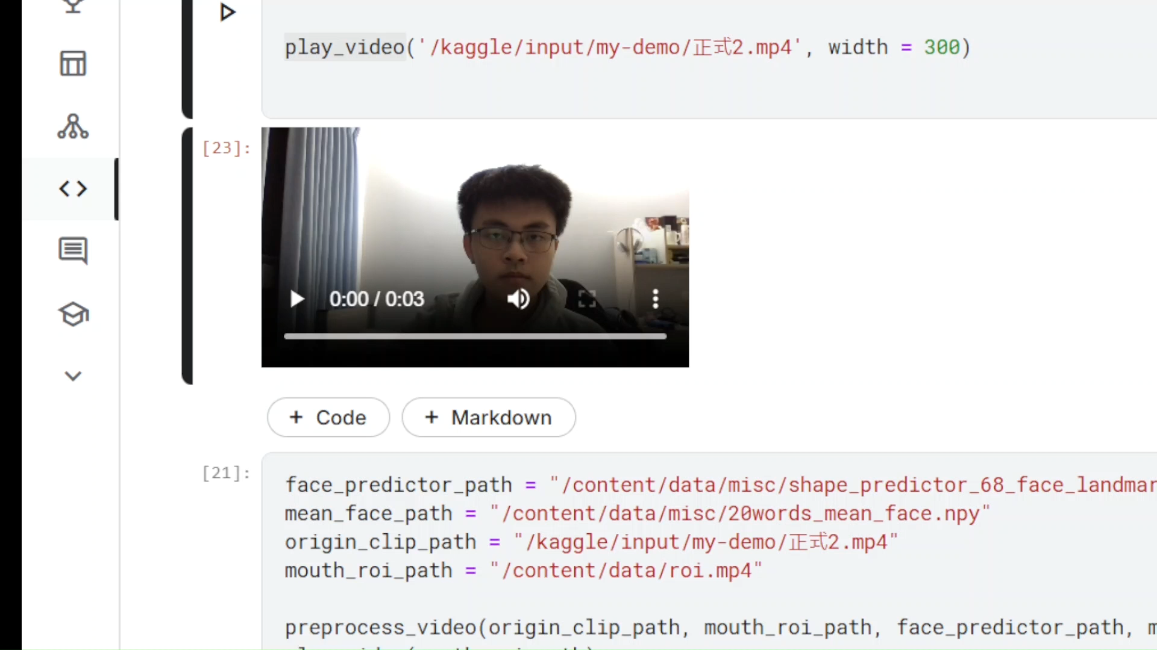
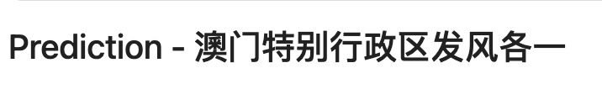
Result - Demo Video
Link
Ground Truth - 澳門特別行政區改革開放

Slide 14
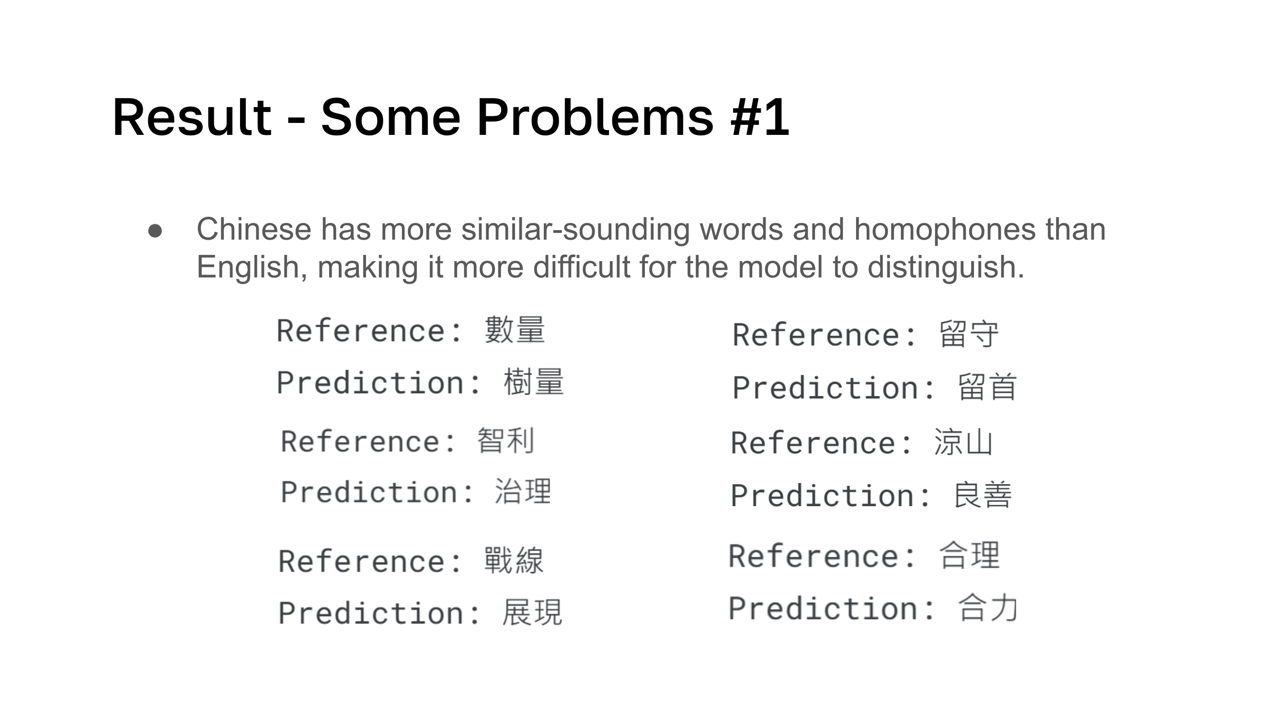

Slide 15
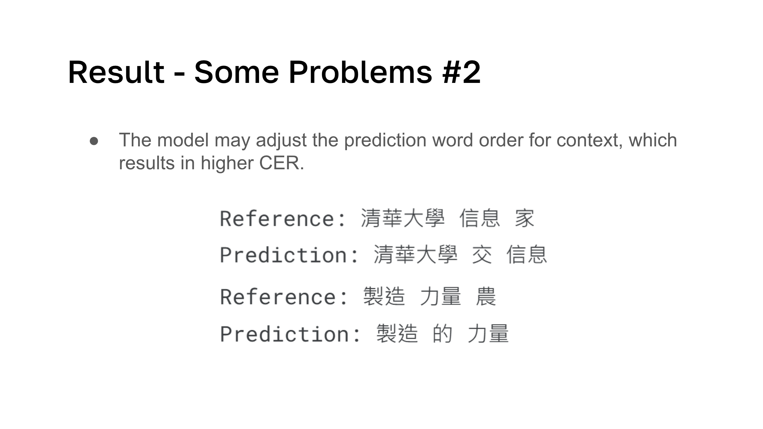

Slide 16
Conclusion
We trained the AV-HuBERT model based on CMLR dataset to predict the Chinese language.
We discovered that different methods of constructing vocabulary lists can affect the accuracy.
We showed that using Audio-Visual instead of only visual data can significantly decrease the character error rate for Chinese language.

Slide 17
Thank you!

Slide 18
Reference
[1]
[2]
[3]
AV-HuBERT (Audio-Visual Hidden Unit BERT)
https://github.com/facebookresearch/av_hubert
Ya Zhao, Rui Xu, and Mingli Song. A Cascade Sequence-to-Sequence Model for Chinese Mandarin Lip Reading. ACM International Conference on Multimedia in Asia 2019
https://dl.acm.org/doi/pdf/10.1145/3338533.3366579
Bowen Shi, Wei-Ning Hsu, Kushal Lakhotia, Abdelrahman Mohamed. Learning Audio-Visual Speech Representation by Masked Multimodal Cluster Prediction, In ICLR 2022
https://arxiv.org/pdf/2201.02184

